Slide 1
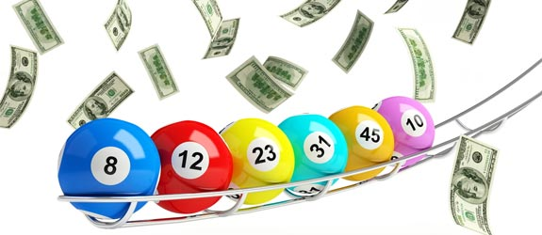
Invisible Iceberg
6/49 Lottery game
Klichov Faridun U1510016
Botirov Erkinboy U1510060
Yusupov Afzal U1510049

Slide 2
6/49 Lottery game
There would be 50 numbers from 0 to 49, among them 6 lucky numbers are automatically selected by lottery balls machine.
Participants choose their 6-number combinations before the game will start and information about all chosen combinations would be given to the organizers. Order of numbers do not matter.
If someone, who can find 5 numbers form lucky numbers, will be rewarded with exact amount of money.
When someone can predict all 6 lucky numbers, of course he will hit the jackpot.
The main goal of our application is to find winners among huge amount of participants quickly and correctly

Slide 3
Implementation of Hash Table (Separate Chaining)
6/49 Lottery game
Hashing – to create unique key.
Find – find6, find5-find lucky 6 and 5 numbers combinations.
Put – to map combinations into appropriate places.
Compression – find appropriate places.
Because of the key should be unique, we connect numbers, which start from 0 to 49, with the prime numbers, and as we know the product of prime numbers is unique.

Slide 4
Time complexity of functions:
6/49 Lottery game
Hashing – O(1)
Find – find6 - O(1), find5 – O(1)
Put – O(n)
Compression – O(1)

Slide 5


